Slide 1


Case Study
Highlighting Gopuff Differentiators to Drive New User Growth

Slide 2
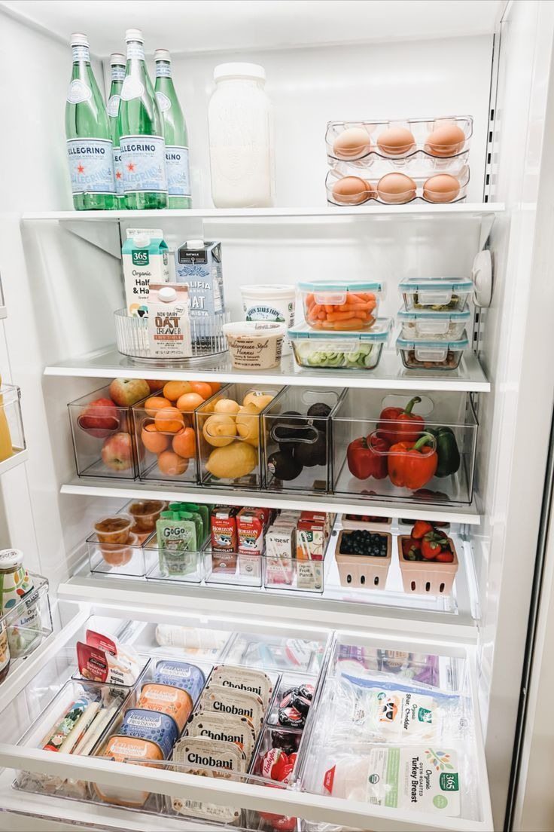
About Gopuff
Gopuff is a leading instant-commerce platform that delivers a wide range of consumer products in as fast as 15 minutes, including groceries, snacks, alcohol, and household items. Unlike most delivery apps that rely on third-party partners, Gopuff operates a fully owned and operated fulfillment network that gives them control over inventory, pricing, speed, and availability. With acceptance of SNAP EBT and HSA/FSA eligible products, Gopuff serves an increasingly broad spectrum of shoppers and needs.

Slide 3

Objective​
Drive awareness and first-time Gopuff orders
Gopuff’s priority is to grow new users by helping consumers understand what the service offers and why it matters in their day-to-day lives. By highlighting Gopuff’s relevance across busy lifestyles and a range of shopping needs through engaging content, influencers aimed to prompt first-time orders in a natural and compelling way.
Challenge​
Standing out in a high-expectation delivery market
Shoppers increasingly expect delivery to be fast, affordable, and reliable. At the same time, shoppers are more closely comparing fees, product prices, and speed before choosing where to place an order. To drive trial, Gopuff needs to clearly articulate its everyday value while speaking to many types of instant-need moments across categories.

